Slide 1
Configuring Host Names and Name Resolution

Slide 2
Changing the system host name
The hostname command displays or temporarily modifies the system's fully qualified host name.
]# hostname
A static host name may be specified in the /etc/hostname file.
The hostnamectl command is used to modify this file and may be used to view the status of the system's fully qualified host name.
If this file does not exist, the host name is set by a reverse DNS query once the interface has an IP address assigned.

Slide 3
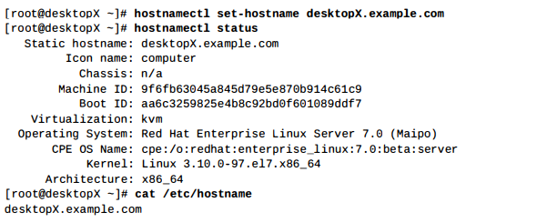
Changing the system host name

Slide 4
Changing the system host name
The static host name is stored in /etc/hostname.
Previous versions of Red Hat Enterprise Linux stored the host name as a variable in the /etc/sysconfig/network file.
Configuring name resolution
The stub resolver is used to convert host names to IP addresses or the reverse.
The contents of the file /etc/hosts a rechecked first.
cat /etc/hosts

Slide 5
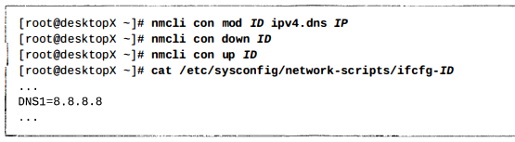
Changing the system host name
cat /etc/resolv.conf
Network Manager will update the /etc/resolv.conf file using DNS settings in the connection configuration files. Use the nmcli to modify the connections.
nmcli con mod KH2 ipv4.dns 192.168.8.8

Slide 6
Changing the system host name
The default behavior of “nmcli con mod ID ipv4.dns IP” is to replace any previous DNS settings with the new IP list provided.
A +/- symbol in front of the ipv4.dns argument will add
or remove an individual entry.
nmcli con mod ID ipv4.dns IP

Slide 7
Changing the system host name
The host HOSTNAME command can be used to test DNS server connectivity.
[root@desktopX -]# host classroom.example.com
OR
[root@desktopX -]# host 192.168.8.8
192.168.8.8 in-addr . arpa domain name pointer classroom.example. com.

Slide 8
Changing the system host name
If DHCP is in use, /etc/resolv.conf is automatically rewritten as interfaces are started, unless you specify PEERDNS=no in the relevant interface configuration files.
The change can be made with nmcli.
With Network Manager disabled, PEERDNS setting "no" must prevent resolv.conf being overwritten for any manual editing.

Slide 9
Changing the system host name
What does Peerdns mean?
The ifcfg parameter PEERDNS determines if the file /etc/resolv. conf file is modified or not.
If it is set to a yes then the parameters DOMAIN, DNS1 and DNS2 will be used to set search and nameservers entries in the file /etc/resolv. conf.
If PEERDNS is set to no then the file /etc/resolv.conf is not modified.

Slide 10
Changing the system host name
The script /etc/sysconfig/network-scripts/ifup-post performs any changes to resolv.conf.
So these lines added to the file /etc/sysconfig/network-scripts/ifcfg-eth0.
PEERDNS=yes
DOMAIN=test.corp.net
DNS1=192.168.1.1
DNS2=192.168.1.2

Slide 11
Changing the system host name
Will result in the following /etc/resolv.conf file.
# cat /etc/resolv.conf
nameserver 192.168.1.1
nameserver 192.168.1.2
search test.corp.net
You would want to limit these parameters to only one ifcfg-ethx file. If you have multiple DNSxand DOMAIN parameters in different files the resolv.conf you get would be based on the last interface that was brought up.
PEERDNS defaults to no unless DHCP is used, in which case it defaults to yes.

Slide 12
Changing the system host name
Steps to Reproduce:
1.Disable network manager
#systemctl disable NetworkManager
2.Setup networking with static IP on /etc/sysconfig/network-scripts/ifcfg-eth0
Add line "PEERDNS=no" in the end.
3.update /etc/resolv.conf with addition nameserver etc

Slide 13
Changing the system host name
Steps to Reproduce:
4.systemctl restart network
5.check if the resolv.conf was overwritten
Actual results:
/etc/resolv must be preserved after reboot/network restart
Expected results:
Manual additions to /etc/resolv gets overwritten/removed

